Slide 1


Capstone Project Spend Analytics

Slide 2
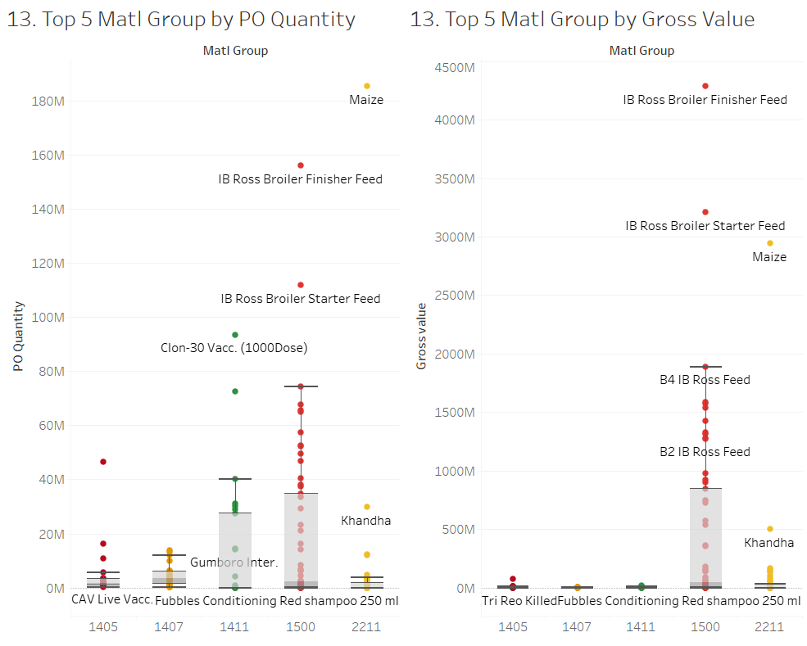
Comparing both charts it is apparent that the highest amount spent is for purchasing poultry feed (IB Ross and Maize) in Material Groups 1500 and 2211 amongst the other top material groups.

Slide 3
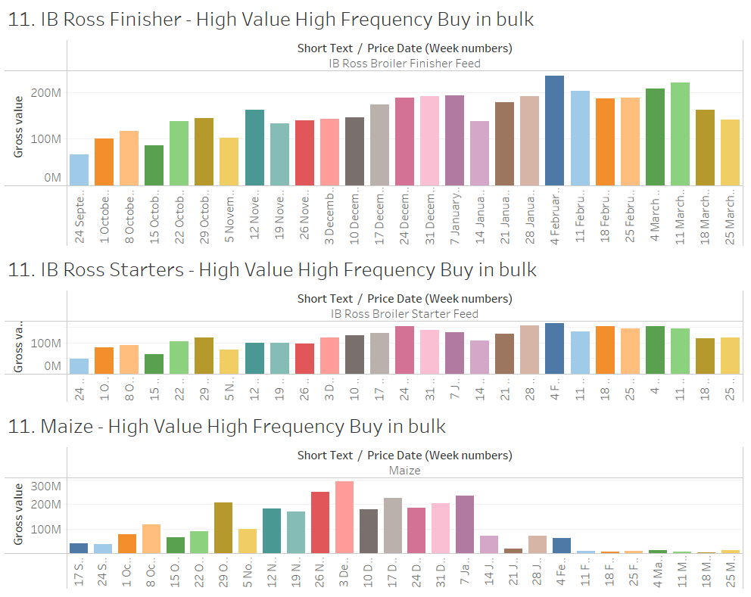
We can see that the top feeds are being ordered frequently (weekly). For the company to save money we suggest ordering in bulk either on a monthly basis or on a quarterly basis.

Slide 4
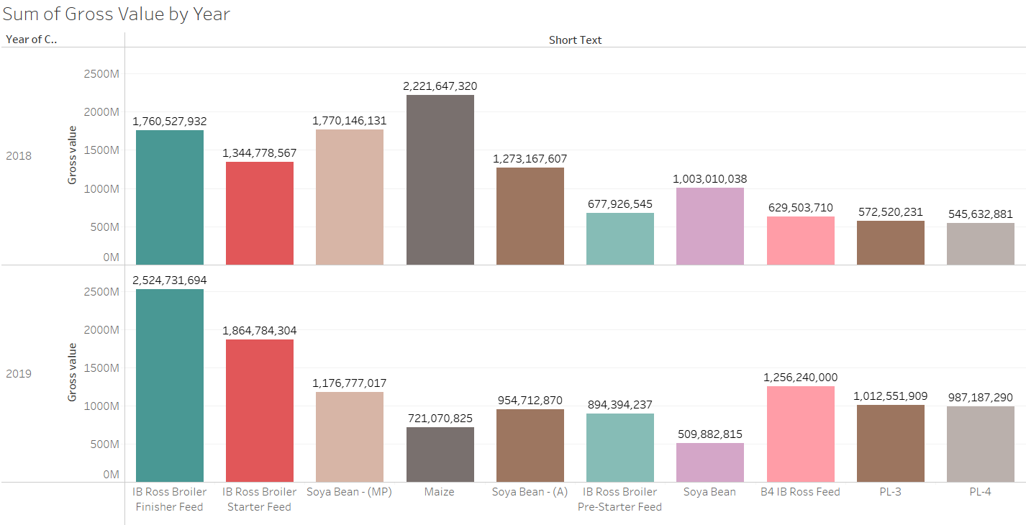
We can visualise the difference between the sum of Gross Values in 2018 and 2019 across the top 10 products.

Slide 5
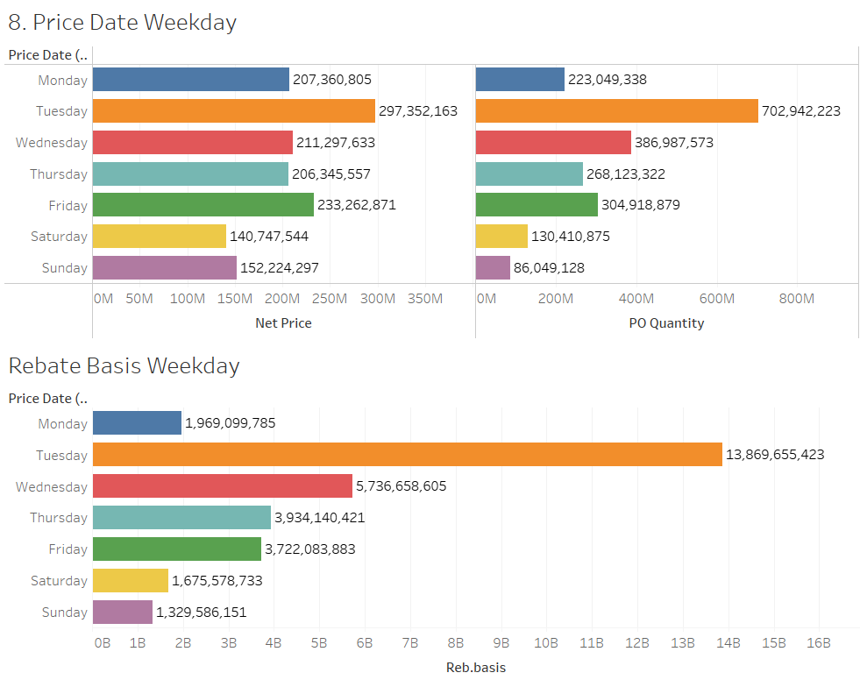
We can see that the sum of materials ordered on Tuesdays is more compared to all other days.
This is congruent with the rebate basis offered on Tuesdays which is the highest compared to other weekdays and the weekend.
Therefore the high ordering of materials on Tuesdays is ideal.

Slide 6
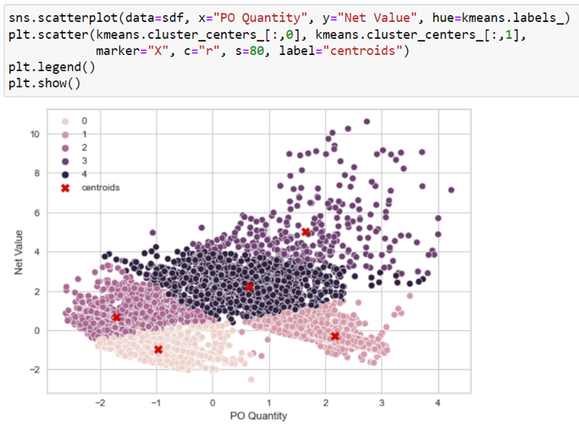
Kmeans Clustering
Based on the Kmeans clustering algorithm we have created clusters using features like Net Value and PO Quantity. Consequently we can see Cluster 3 as the High Net Value High PO Quantity cluster and Cluster 0 as the Low Net Value Low PO Quantity cluster and so on.

Slide 7
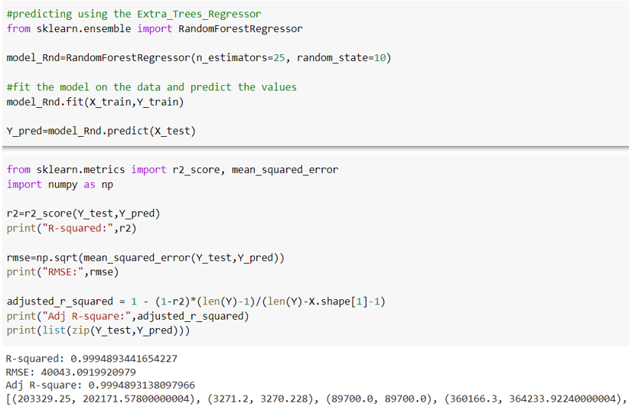
Random Forest Regressor
Considering Net Value as our target variable the RandomForestRegressor model has been built. Based on the other input variables giving an R-squared of 0.99 suggesting that future values can be predicted accurately.

Slide 8
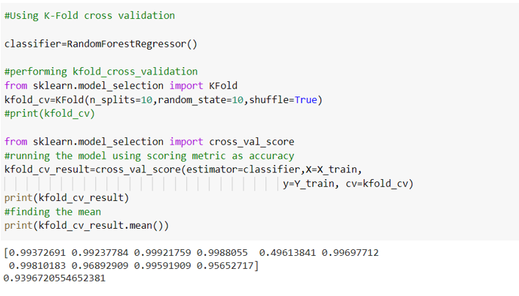
K-Fold Cross Validation
To validate our results from RandomForestRegressor we use K-Fold Cross Validation which gives us a validation score of 0.93 suggesting that our RandomForestRegressor is not overfitting.

Slide 9
Conclusion
Based on our analysis we can see that the data belongs to a poultry company owing to products like feeds, maize, soya bean and poultry specific vaccines.
We have seen a very high number of purchase orders and requesters for the same products. Additionally, we have observed the weekly ordering of higher quantities of top products.
Hence, we recommend consolidation of POs and requesters to enable cost saving through bulk purchases. This in turn can eliminate redundancies and help optimise the procurement process.
On further examination we discovered that the highest quantities were ordered on Tuesdays which went hand in hand with high rebate basis on Tuesdays. Thus, we can conclude that higher cost savings can be achieved by ordering on Tuesdays as opposed to the other weekdays or weekends.

